Slide 1
ETHICAL HACKING ASSESMENT

Slide 2
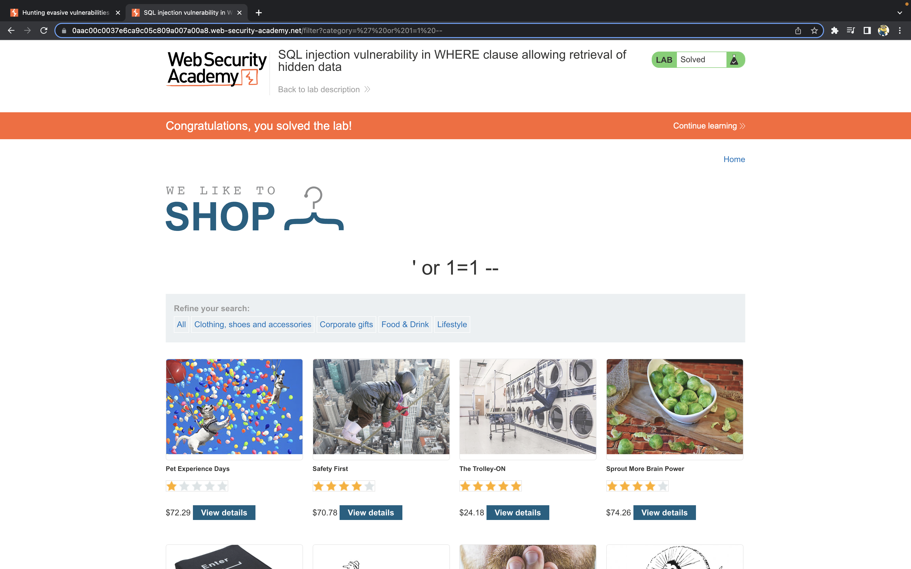
SQL injection vulnerability in WHERE clause allowing retrieval of hidden dataSQL injection vulnerability in WHERE clause allowing retrieval of hidden data

Slide 3
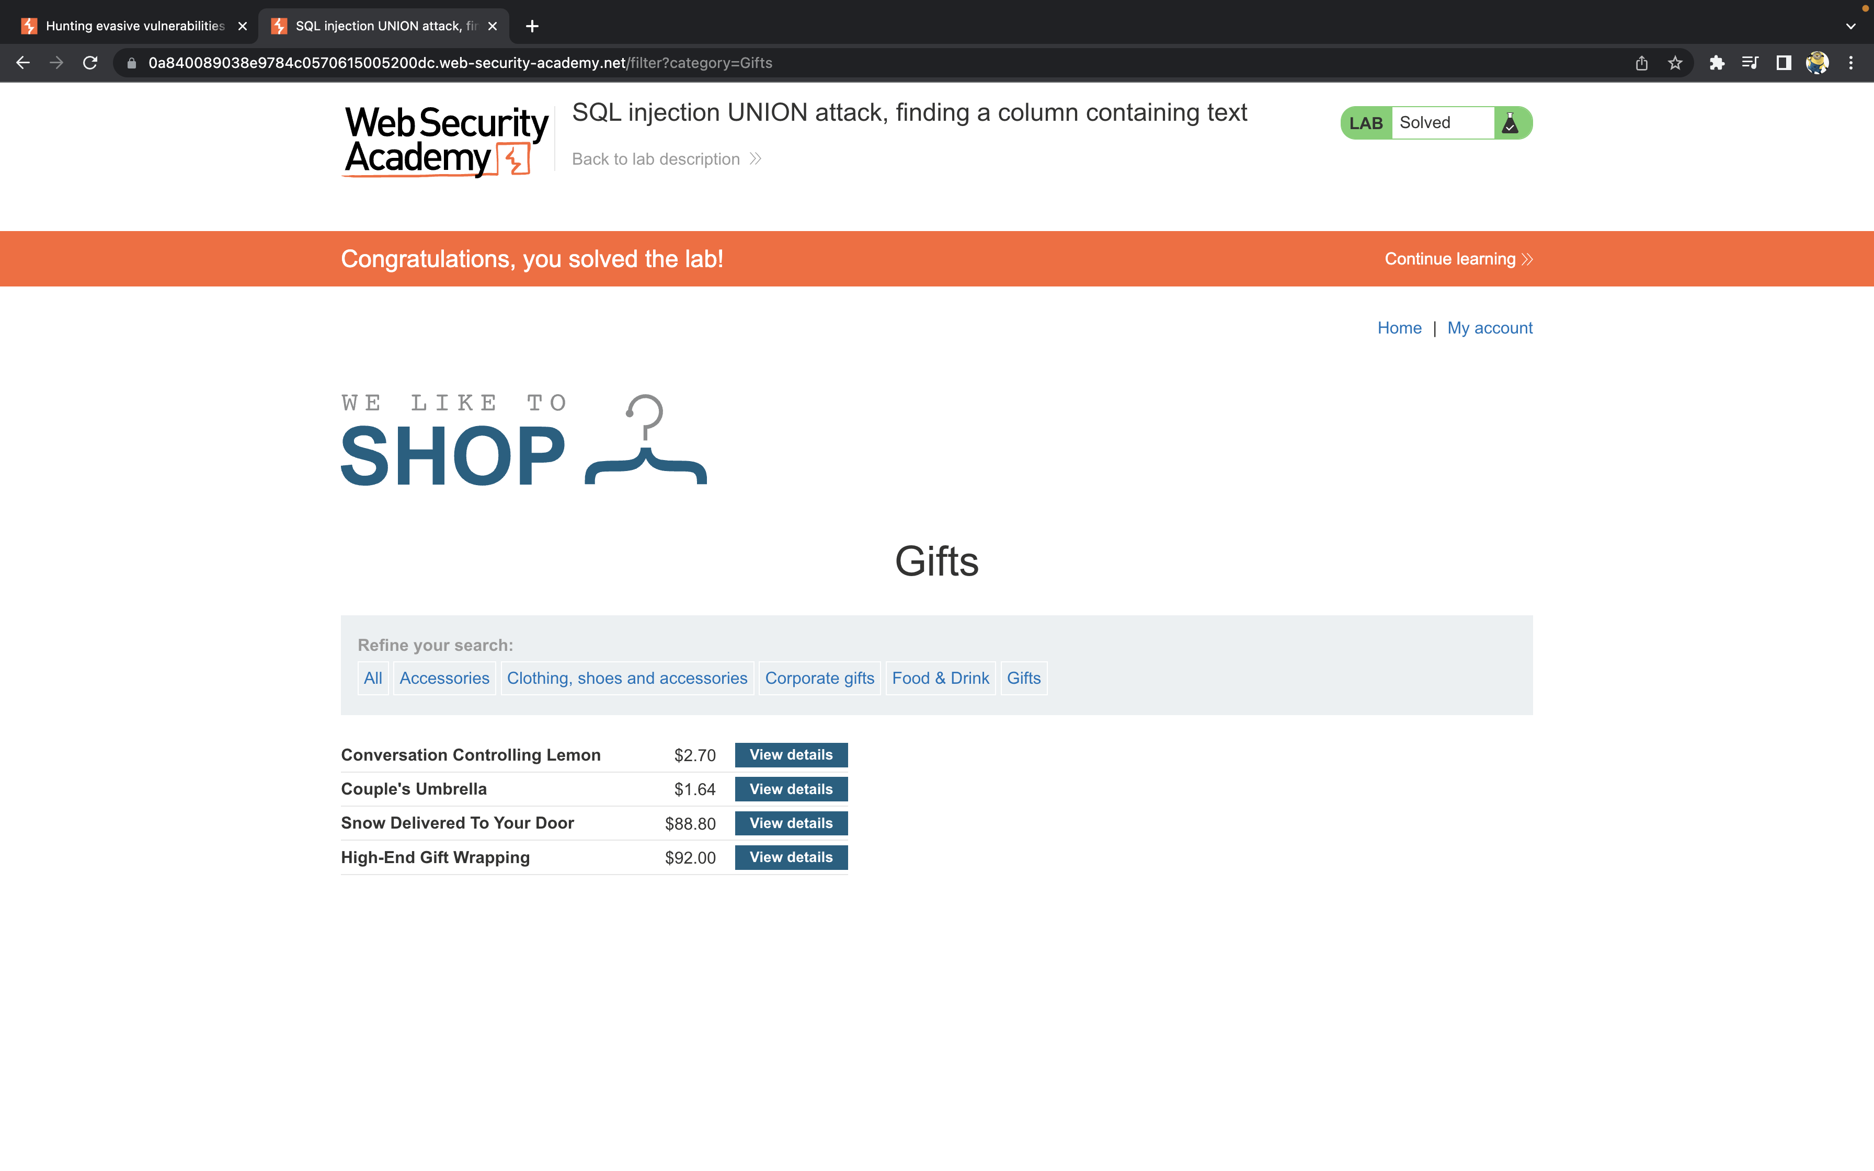
SQL injection UNION attack, finding a column containing text

Slide 4
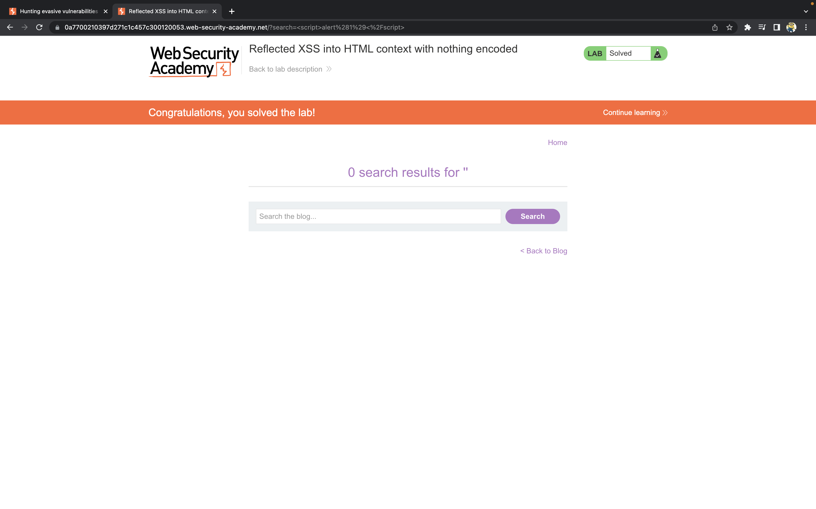
Reflected XSS into HTML context with nothing encoded

Slide 5
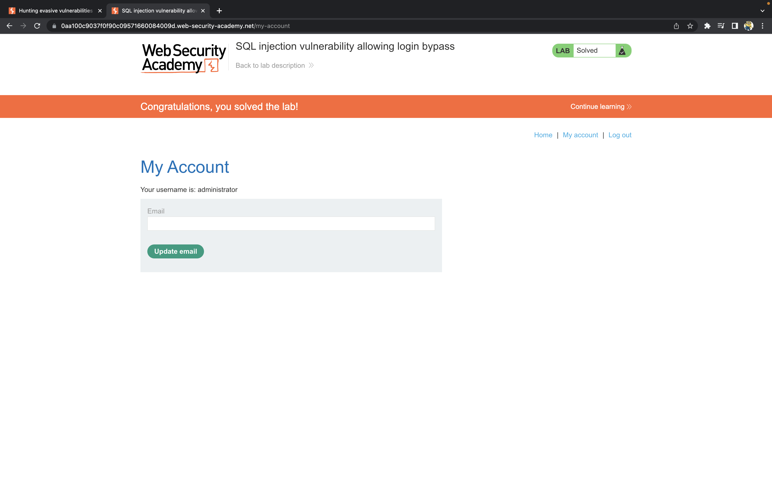
SQL injection vulnerability allowing login bypass

Slide 6
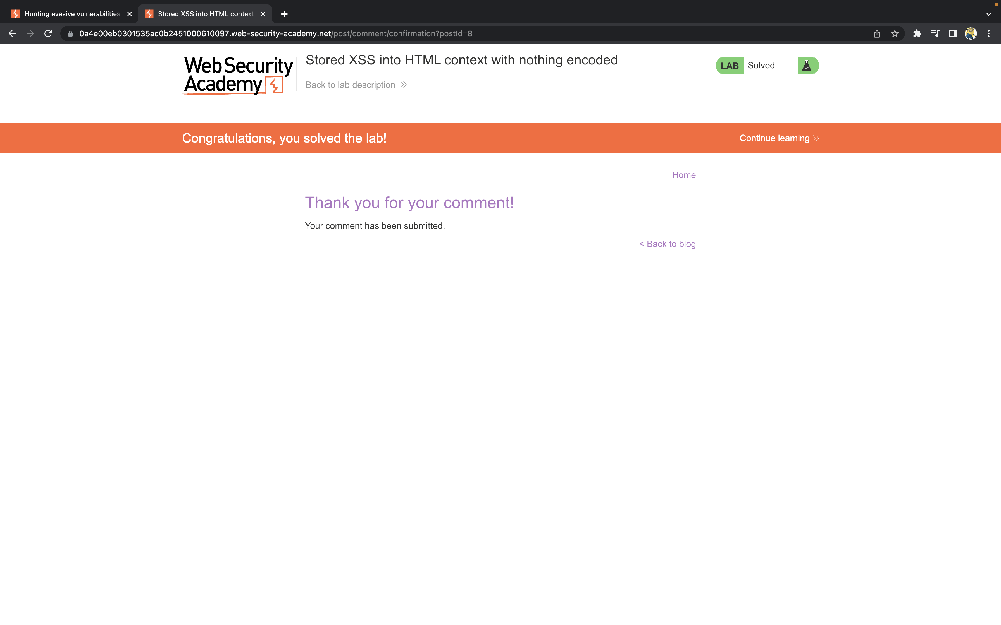
Stored XSS into HTML context with nothing encoded

Slide 7
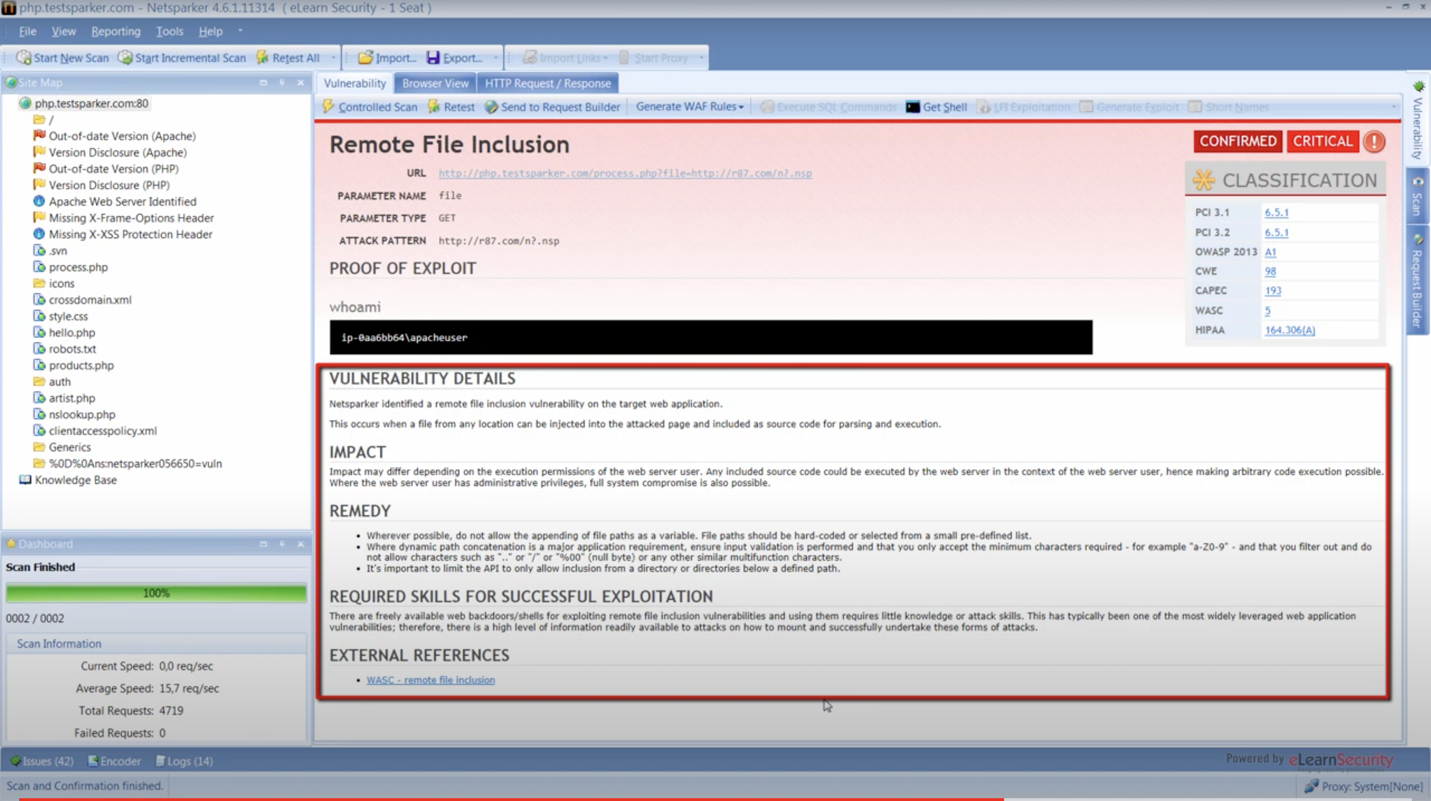
Testsparker vulnerability found

Slide 8
Created by
K. Thapaswin Reddy

